Slide 1



SMART ATTENDANCE AND SERVICES
- ALIEN ARCHITECTS

Slide 2

Teammates :
Mohanasundaram.G
Praveena.J.P
Bhuvanesh.K
Srimathi.B

Slide 3
PROBLEM STATEMENT:
Time consuming process especialy in larger class rooms or schools with multiple classes using manual attendence.Inaccurate or incomplete information provided by students leading to mistakes in attendence records.Reliance on manual record keeping methods such as paper based attendence sheet which can be inconvinent and prone to errors

Slide 4
PROPOSED SOLUTION:
Our solution is to create an app in which the attendence are recorded through cameras using face recognition while entering the class .This system ensures realtime monitoring by instantaneous tracking attendence and by sending notifications ensuring their presence or absence.

Slide 5
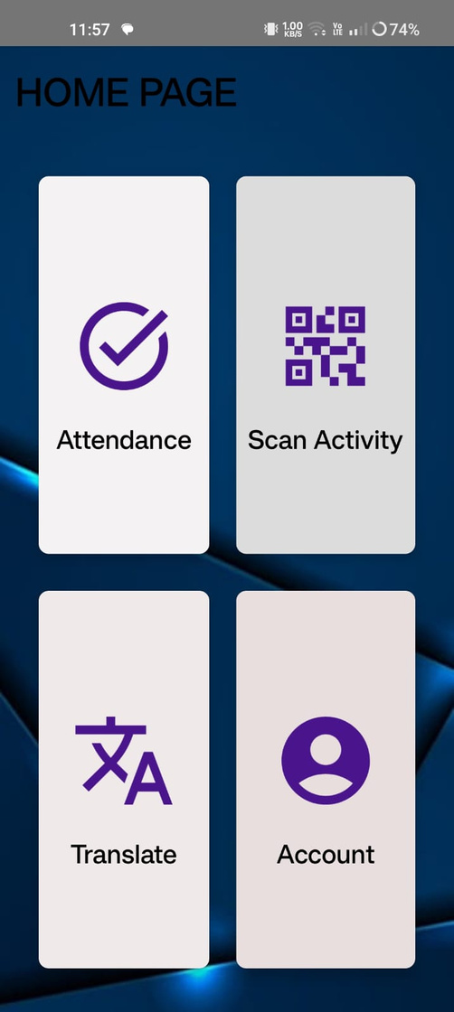

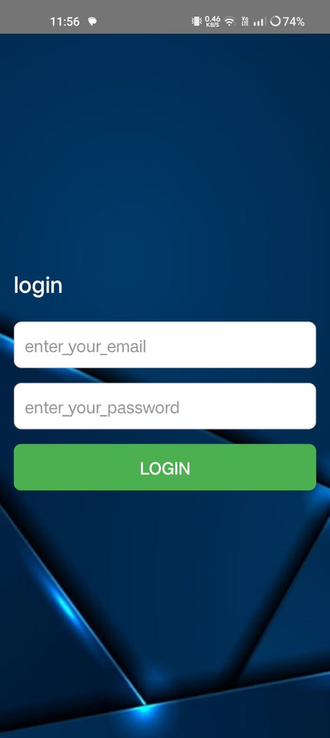
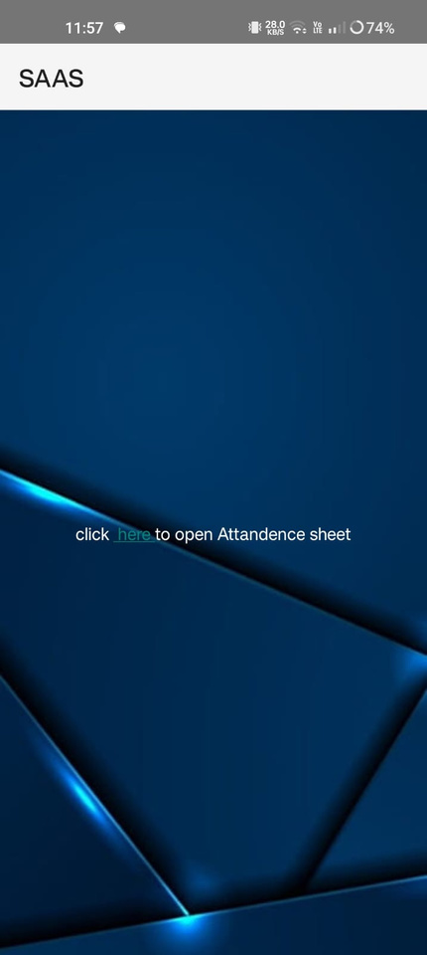
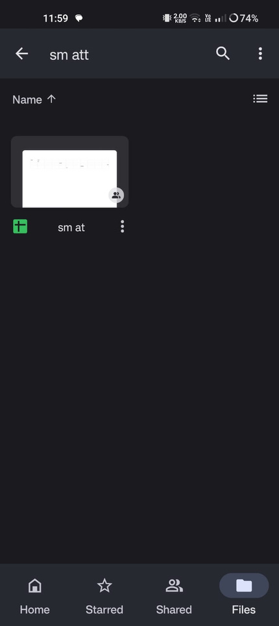

Slide 6
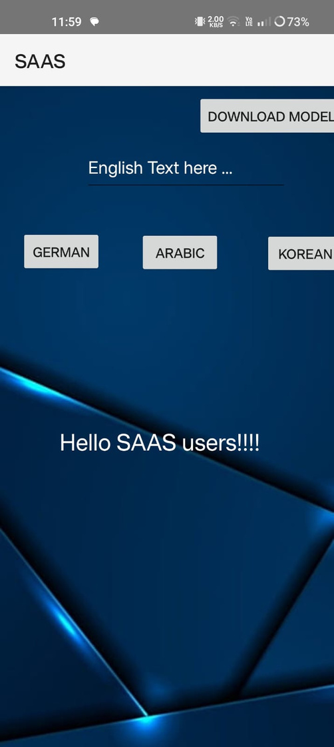

Slide 7
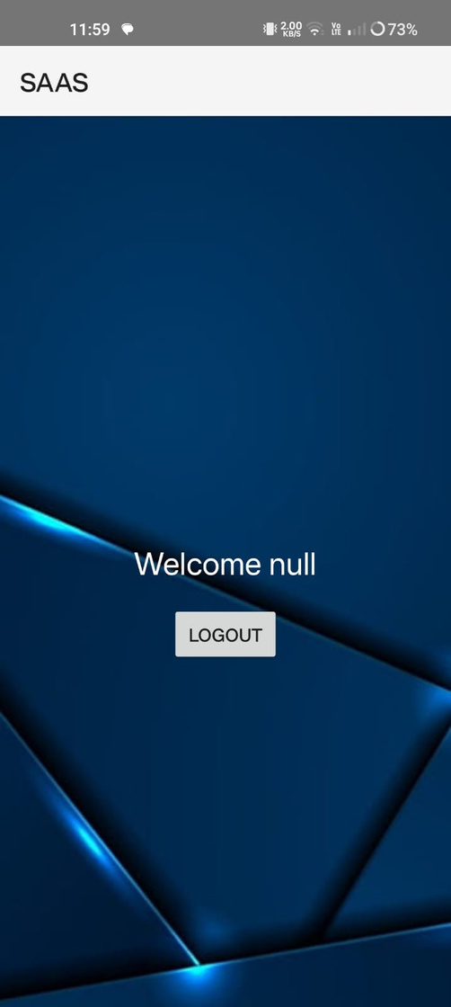

Slide 8
THANK YOU

